Slide 1
Freight Performance Management and Measurement across Multistate Jurisdictions
Supply Chain Case Studies
Briefing for U.S. Dept. of Commerce ACSCC
Washington, DC
Lance R. Grenzeback, Cambridge Systematics, Inc.
Joseph G.B. Bryan, Parson Brinckerhoff
June 10, 2014

Slide 2
Project
Objective
Demonstrate and improve the measurement of freight transportation performance using a supply chain perspective
Case Study Sponsors
U.S. Department of Commerce, Advisory Committee on Supply Chain Competitiveness
FHWA, Office of Freight Management
I-95 Corridor Coalition, Intermodal Committee

Slide 3
Supply Chain Case Studies
Retail – Target® consumer goods
From Ports of Los Angles/Long Beach via Chicago to New York
Autos – General Motors auto parts
From suppliers to auto assembly plant in Tennessee
Food – Perdue processed chicken
From DelMarVa region to Mid-Atlantic markets
Agriculture – Soybean exports
From Illinois farms to Louisiana port
Electronics – Panasonic electronics
Between manufacturing and assembly facilities in San Diego and Tijuana

Slide 4
Scope
Address performance of supply chains
But not the performance of modes, networks, etc., or environmental and economic impacts
Address performance of public and quasi-public links and nodes
Include ports, highways, rail lines, airports, etc., but not private-sector manufacturing, warehousing or distribution nodes
Use measures and metrics that are common across supply chains and “drill down”
Focus on high-level performance of representative supply chains to inform national policy
Cover key industries, national regions, major trade lanes, but do not duplicate firm-, carrier- and agency-level analysis

Slide 5
Performance Measures and Metrics
Measure | Metric
Transit time | Travel time in days (or hours)
Reliability | 95% travel time in days (or hours)
Safety | Fatality and injury rate
Cost | Dollars
Risk | Cargo loss and damage (accidents, poor handling, theft…)
 | Disruption (storms, labor, political forces…)
 | Capacity expansion delays (physical, regulatory limitations and delays…)

Slide 6
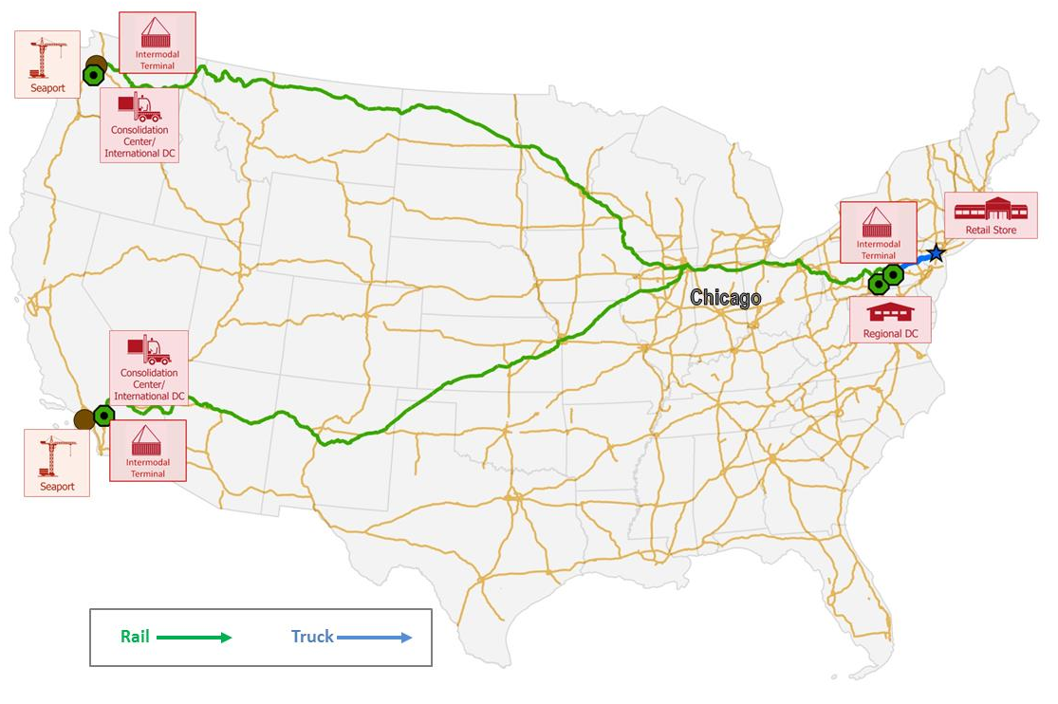
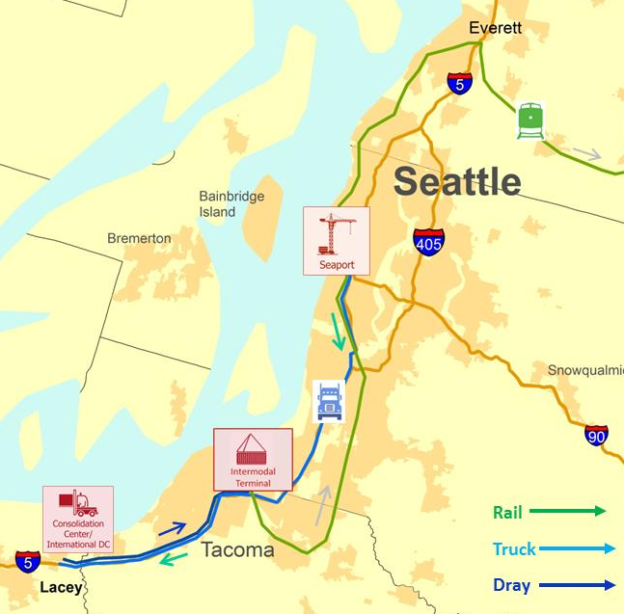
Retail Supply Chain (Target)

Slide 7
Retail Supply Chain Measures
Links and Nodes | Transit Time/Dwell Time (Hours) | Reliability (95% travel time)
West Coast port (SEATTLE)
Dray move | 1.1 | 4.3
Transload or Consolidation Center
Dray move | 0.8 | 3.3
West Coast rail intermodal terminal
Rail move
Midwest rail intermodal interchange
Rail move
East Coast rail intermodal terminal
Dray move | 1.0 | 2.7
East Coast Regional Distribution Center
Truck P&D move | 3.5 | 6.5
Retail Store
Totals
Estimated using Google travel time with TTI’s Planning Time Index. Rail to be derived from Railinc, RSI Logistics or Transcore data.

Slide 8
Retail Supply Chain Measures
Links and Nodes | Transit Time/Dwell Time (Hours) | Reliability (95% travel time)
West Coast port (LA/LB)
Dray move | 1.2 | 5.8
Transload or Consolidation Center
Dray move | 0.3 | 1.3
West Coast rail intermodal terminal
Rail move
Midwest rail intermodal interchange
Rail move
East Coast rail intermodal terminal
Dray move | 1.0 | 2.7
East Coast Regional Distribution Center
Truck P&D move | 3.5 | 6.5
Retail Store
Totals
Estimated using Google travel time with TTI’s Planning Time Index. Rail to be derived from Railinc, RSI Logistics or Transcore data.

Slide 9
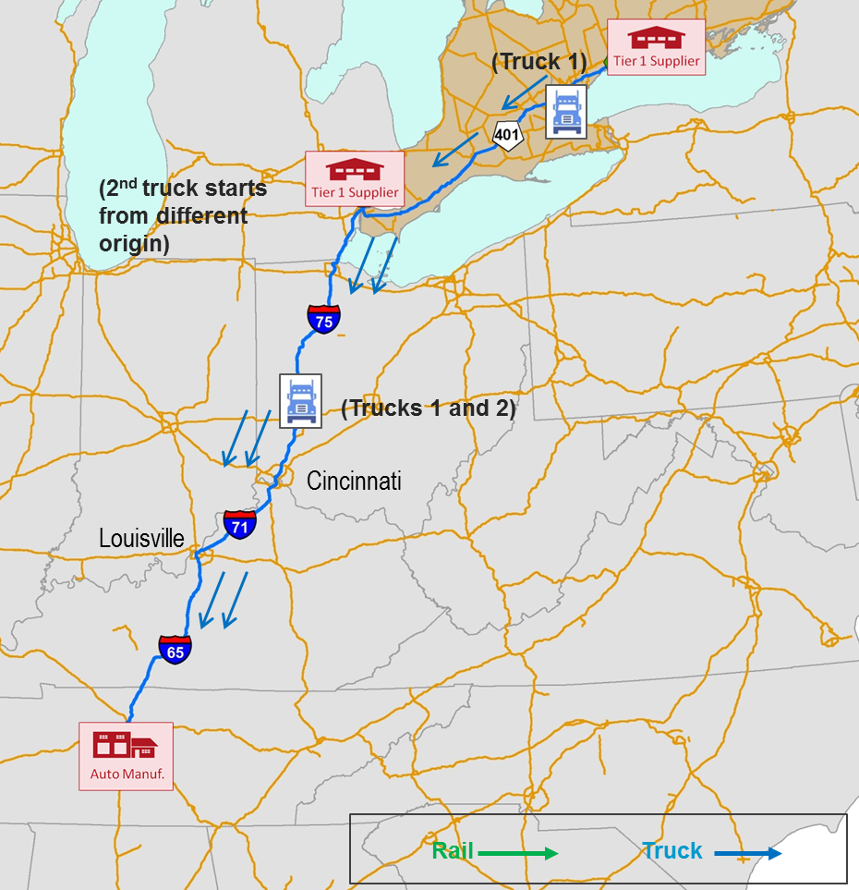
Automotive Supply Chain/TL (General Motors)

Slide 10
Automotive Supply Chain Measures/TL
Links and Nodes | Transit Time/Dwell Time (Hours) | Reliability (95% travel time)
Parts Supplier Plant, Chatham, Ontario
Truckload move (through) | 20.3 | 28.5
General Motors Plant, Spring Hill, TN
Totals | 20.3 | 28.5
Links and Nodes | Transit Time/Dwell Time (Hours) | Reliability (95% travel time)
Parts Supplier Plant, Chatham, Ontario
Truckload move
International border crossing |  | 
Truckload move | 17.6 | 24.5
General Motors Assembly Plant, Spring Hill, TN
Totals
Estimated using ATRI data.

Slide 11
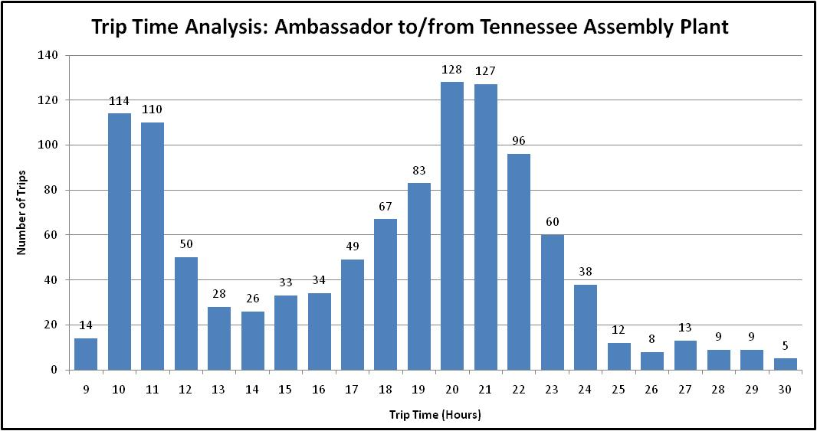
Hours of Service Effect (567 Miles)

Slide 12
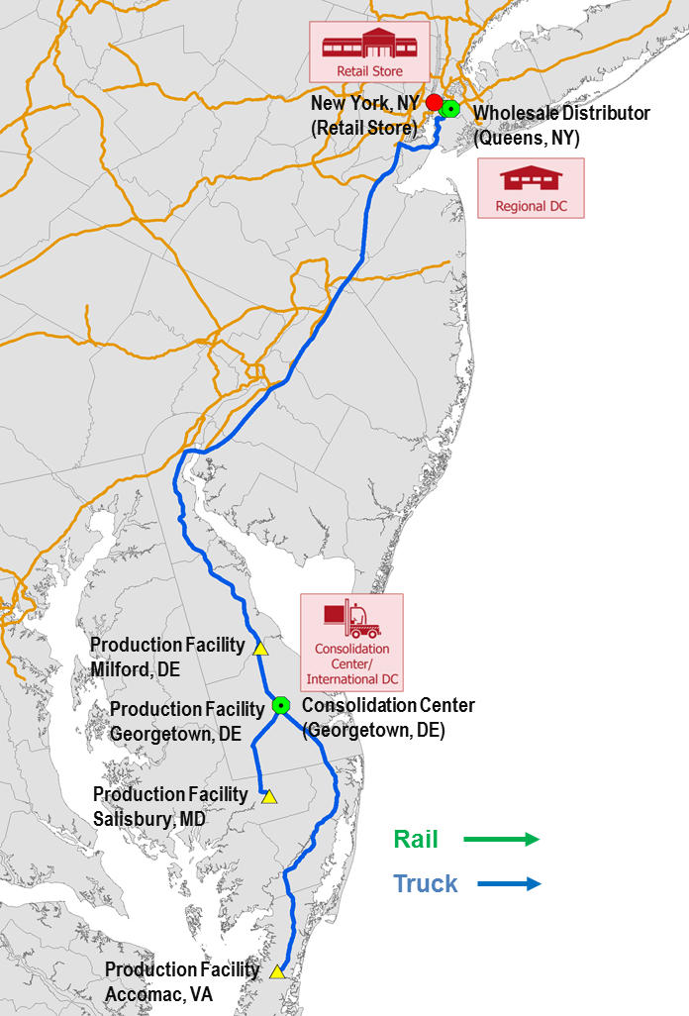
Processed Food Supply Chain (Perdue)

Slide 13
Processed Food Supply Chain Measures
Links and Nodes | Transit Time/Dwell Time (Hours) | Reliability (95% travel time)
Production Facility, Accomac, VA
Truckload move | 1.6 hours | 1.8 hours
Consolidation Facility, Georgetown, DE
Truckload move | 3.7 hours | 4.4 hours
Distribution Facility, Brooklyn, NY
Totals | 5.3 hours | 6.2 hours
Estimated using NPMRDS (HERE) data.

Slide 14
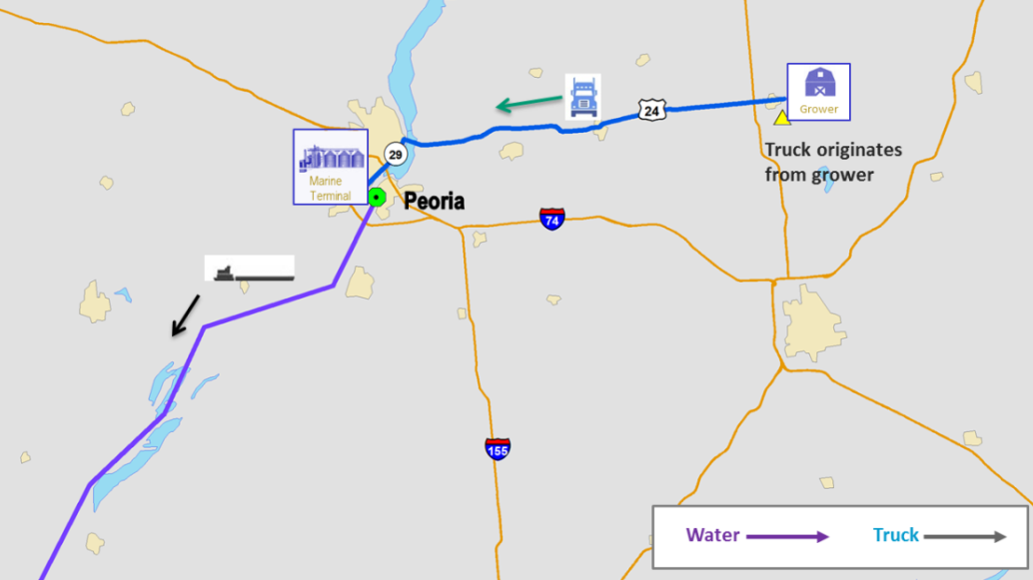
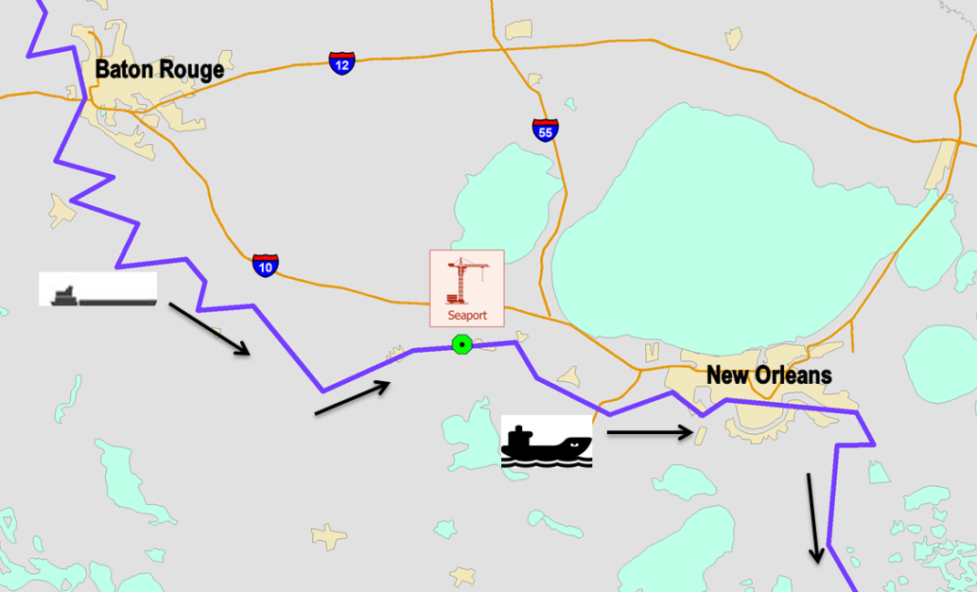
Agricultural Export Supply Chain (soybeans)

Slide 15
Agricultural Export Supply Chain Measures
Links and Nodes | Transit Time/Dwell Time (Days, hours) | Reliability (95% travel time)
Farm in vicinty of El Paso, IL
Truck move | 0.8 hours | 1.7 hours*
ADM/Growmark Peoria Terminal Wharf Port Facility
Barge move | 8.2 days | 14.5 days*
Cargil Loading Facility, Reserve, LA
Totals | 9.0 days | 14.6 days
* Estimated using U.S. Army Corps of Engineers data for the period June 2012 through January 2014; TTI Mobility Report 2012 for 95% index for small urban areas.

Slide 16
Conclusions (preliminary)
We can measure the high-level performance of representative supply chains
Key measures and metrics are common across supply chains and can be scaled for national, multistate and metropolitan use
Travel time and travel time reliability are available from public and private sources, but “some assembly is required…”
Safety data are available, but not readily accessible
Cost data can be purchased from private suppliers
Risk data can be estimated, but are not readily available

Slide 17
Implementation Issues
Data
Characteristics
Definition; reliability & validity; continuous/periodic/seasonal; historical
Availability, access and cost
National and nationwide; scalability
Urban freight stages
Transfers, deliveries, pick-ups
Risk measure(s)
Application
Representative market basket of supply chains
Industries, supply chains, geographies: how much is enough?
Public sector applications
Inventory and diagnostics: Conditions & Performance Report
Planning and programming: Freight Plans and Programs
Performance management
Private sector applications
Competitive benchmarking

Slide 18
Freight Performance Management and Measurement across Multistate Jurisdictions
Supply Chain Case Studies
Briefing for U.S. Dept. of Commerce ACSCC
Washington, DC
Lance R. Grenzeback, Cambridge Systematics, Inc.
Joseph G.B. Bryan, Parson Brinckerhoff
June 10, 2014

